Slide 1

VALLURUPALLI NAGESWARA RAO VIGNANA JYOTHI INSTITUTE OF ENGINEERING AND TECHNOLOGY
Department of Computer Science and Engineering
MACHINE LEARNING
Dr. Kriti Ohri
Assistant Professor
Department of Computer Science and Engineering

Slide 2
REGRESSION
2

Slide 3

Least Squares Method
Slope for the Estimated Regression Equation
₌ ∑(x_{i} − x )(y_{i} − y )
b
∑(x − x )²
1
i
3

Slide 4

Least Squares Method
y-Intercept for the Estimated Regression Equation
b₀ = y − b₁ x
where:
x_{i} = value of independent variable for ith
observation
y_{i} = value of dependent variable for ith
_
observation
_x = mean value for independent variable
y = mean value for dependent variable
n = total number of observations

Slide 5
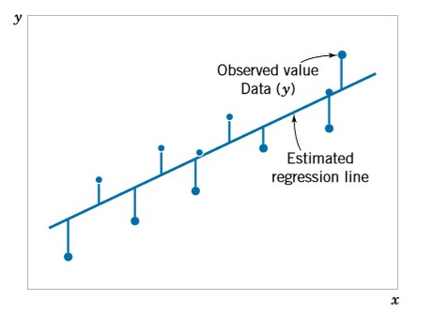
Simple Linear Regression
Deviation from the estimated regression model

Slide 6
Ordinary least square (OLS)
Ordinary least square or Residual Sum of squares (RSS) — Here the cost function is the (y(i) — y(pred))² which is minimized to find that value of β0 and β1, to find that best fit of the predicted line.

Slide 7
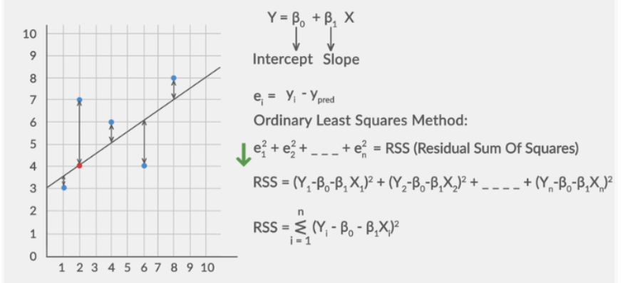
Ordinary least square

Slide 8
Simple Linear Regression
Example: Auto Sales
An Auto company periodically has a special week-long sale.
As part of the advertising campaign runs one or more television commercials during the weekend preceding the sale.
Data from a sample of 5 previous sales are shown on the next slide.

Slide 9
Simple Linear Regression
Example: Auto Sales
Number of
TV Ads
1
3
2
1
3
Number of Cars Sold
14
24
18
17
27

Slide 10


Estimated Regression Equation
Slope for the Estimated Regression Equation
₌ ∑(x_{i} − x )(y_{i} − y ) ₌ 20 ₌ ₅
b
∑(x − x )²
1
4
i
y-Intercept for the Estimated Regression Equation
b₀ = y − b₁ x = 20 − 5(2) = 10
Estimated Regression Equation
yˆ = 10 + 5x

Slide 11

Scatter Diagram and Trend Line
30
25
20
Cars Sold
y = 5x + 10
15
10
5
0
0
1
2
3
4
TV Ads

Slide 12
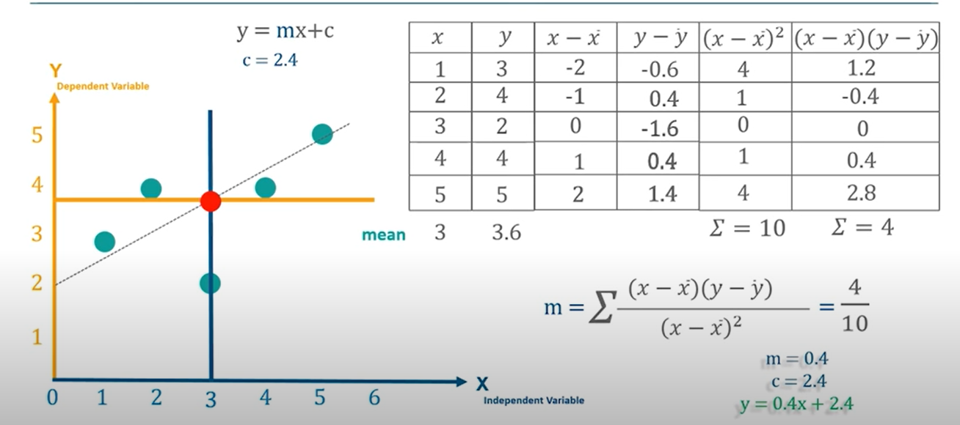
Numerical
C =y − m x

Slide 13
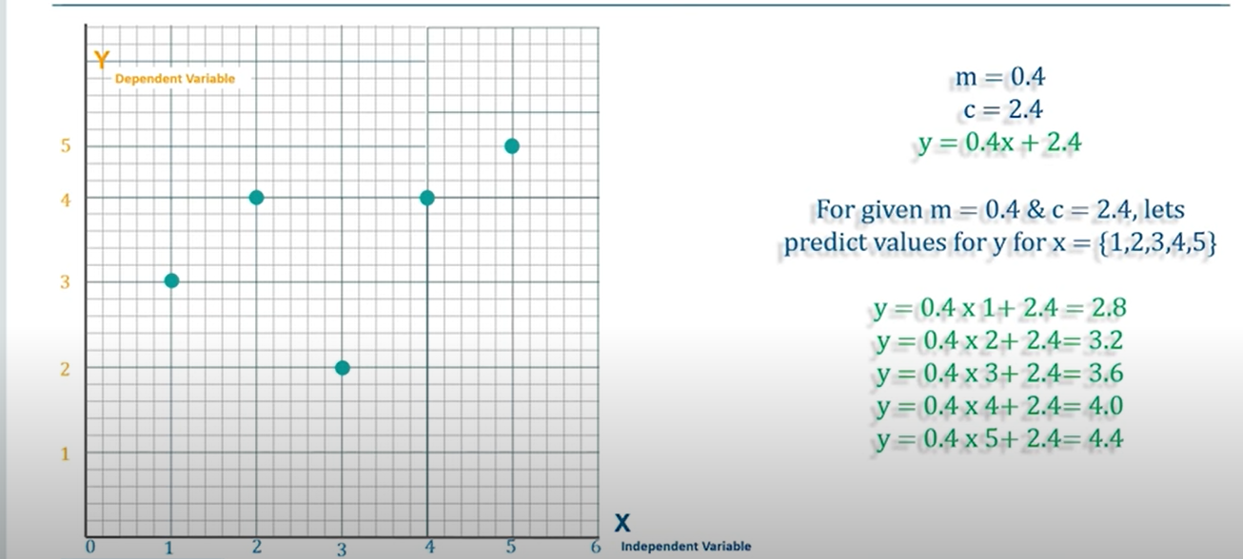

Slide 14
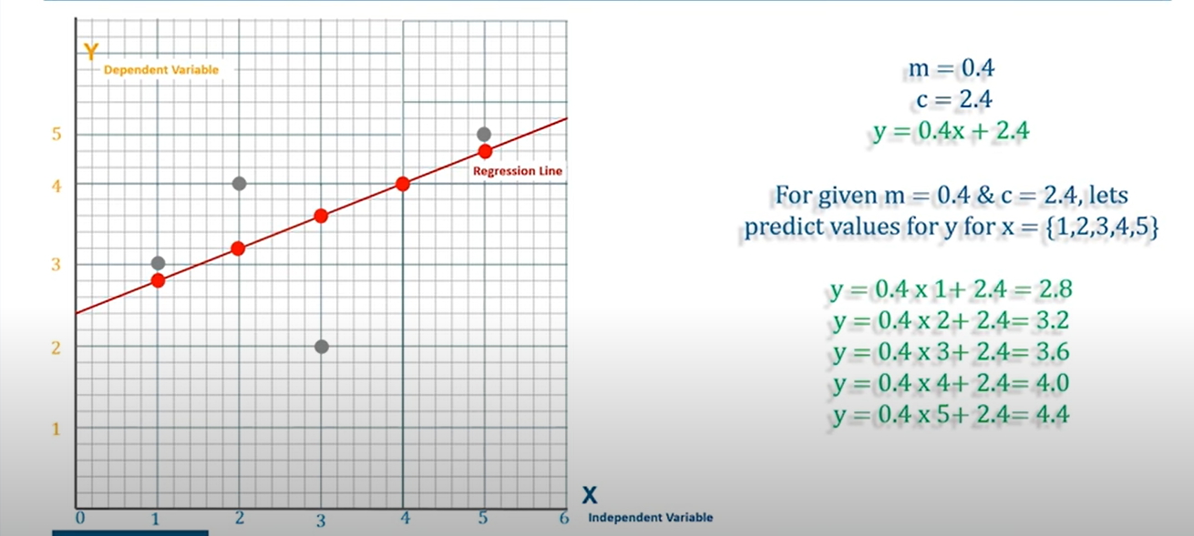

Slide 15
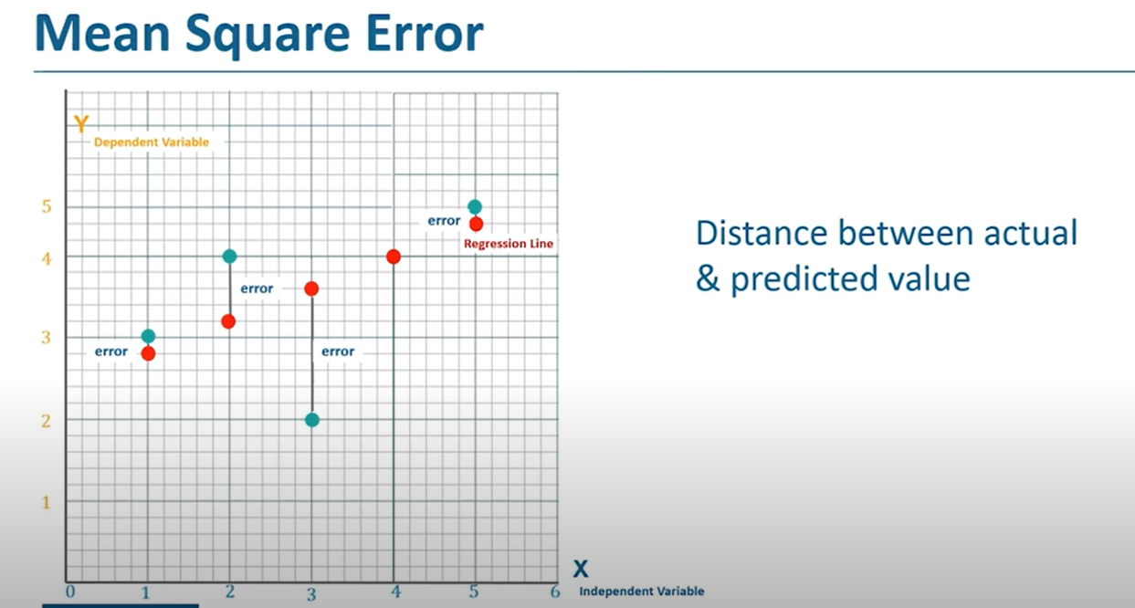

Slide 16
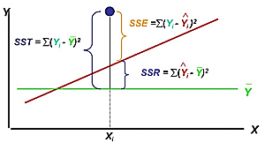
SST: Sum of squares total
SSE: Sum of squares error
SSR: Sum of squares due to regression

Slide 17
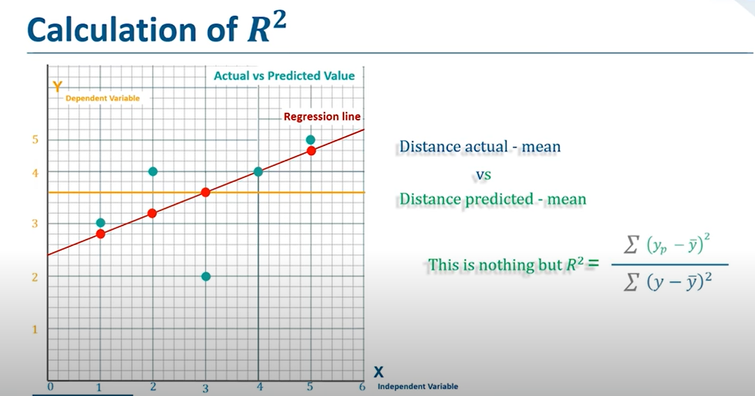
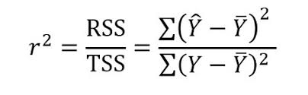

$$R^{2}called coefficient of determination$$
Notes:
R-Squared is a statistical measure of fit that indicates how much variation of a dependent variable is explained by the independent variable(s) in a regression model.

Slide 18
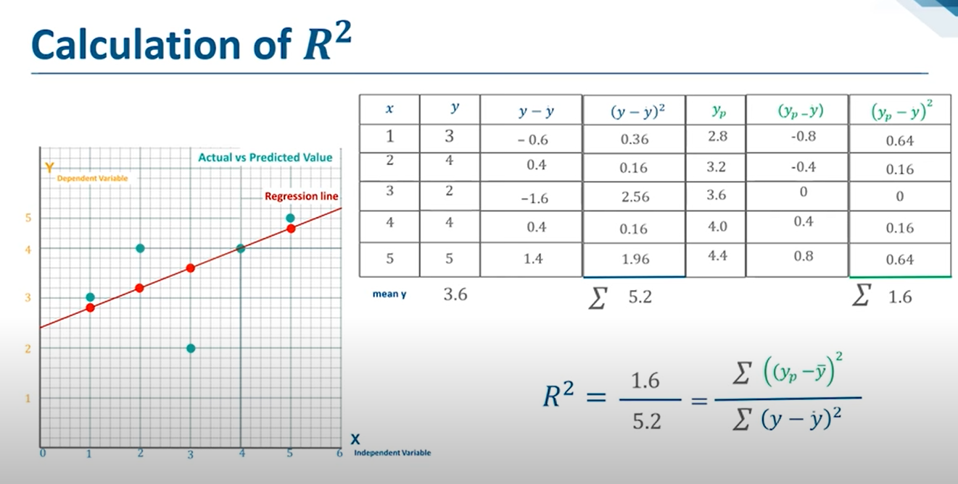

Slide 19
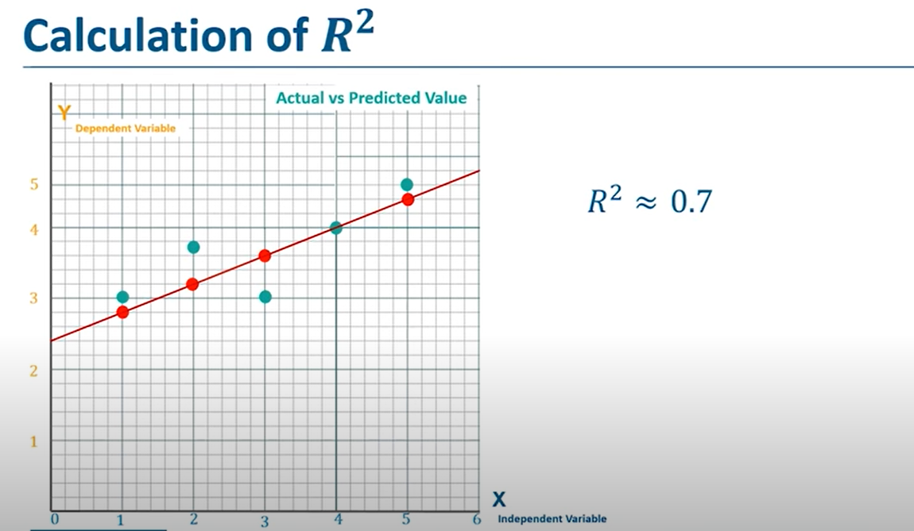

Slide 20
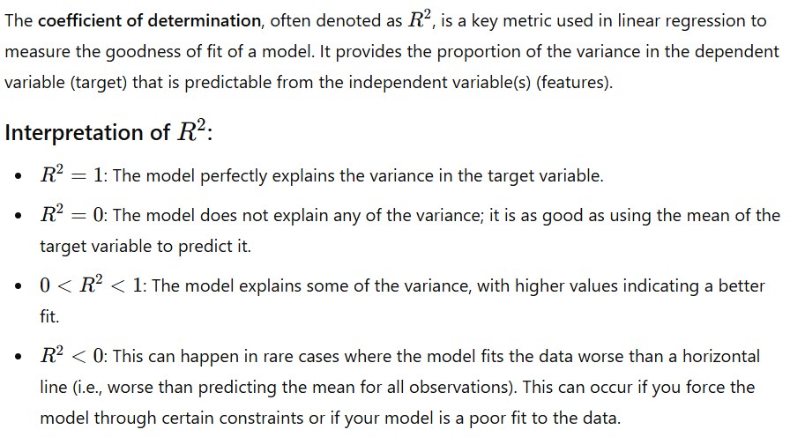

Slide 21
Thank You

